Slide 1
TensorFlow
Data Science Learner’s Series – 10th July 2019
- By Annie Freeman
Collaborative Spirit | Unrelenting Dedication | Expert Thinking

Slide 2
Agenda
1
What is Tensorflow? What are tensors?
2
Building blocks of Tensorflow
3
Directed graph & Computational Graph
4
Benefits/Advantages of Computational Graphs
5
Converting the simple program into a Tensorflow program
6
Tensorboard
7
Installation of Tensorflow, Google Collab, Jupyter Notebook etc.,
8
Build simple neural network program using Tensorflow - Demo

Slide 3
What is Tensorflow?
What are Tensors?
1
Collaborative Spirit | Unrelenting Dedication | Expert Thinking

Slide 4
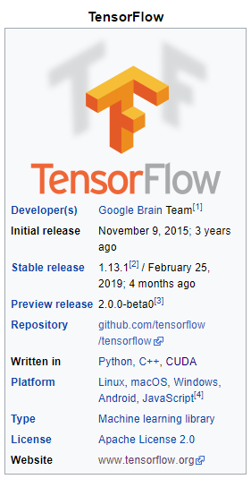
What is Tensorflow?
TensorFlow is a free and open-source software library for numerical computation of mathematical expressions, using data flow graphs.
It is a symbolic math library used for machine learning applications such as neural networks for dataflow and differentiable programming across a range of tasks
Starting in 2011, Google Brain built DistBelief as a proprietary machine learning system based on deep learning neural networks. Refactored codebase of DistBelief into a faster, more robust application-grade library, became TensorFlow.
Version 1.0.0 was released on February 11, 2017. Currently TensorFlow 2.0 Beta is available.
TensorFlow can run on multiple CPUs, GPUs (with optional CUDA and SYCL extensions for general-purpose computing on graphics processing units) and TPUs.
TensorFlow is available on 64-bit Linux, macOS, Windows, and mobile computing platforms including Android and iOS.
TensorFlow computations are expressed as statefull dataflow graphs.

Slide 5
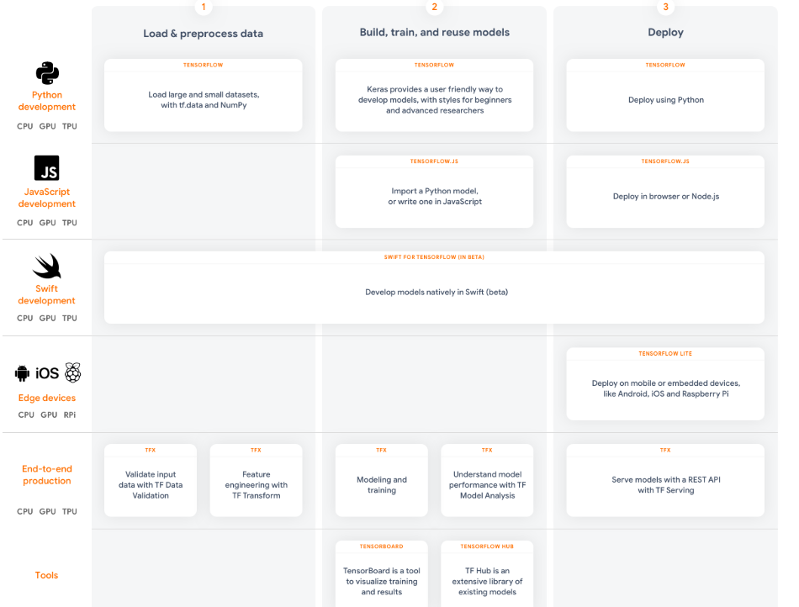
Tensorflow supported Languages & Platforms

Slide 6
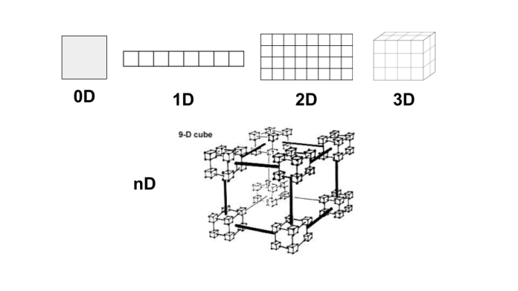
What are Tensors?
Tensors are dynamically sized multidimensional data arrays.
Rank | Entity
0 | Scalar
1 | Vector
2 | Matrix
3 | 3-Tensor
n | n-Tensor

Slide 7
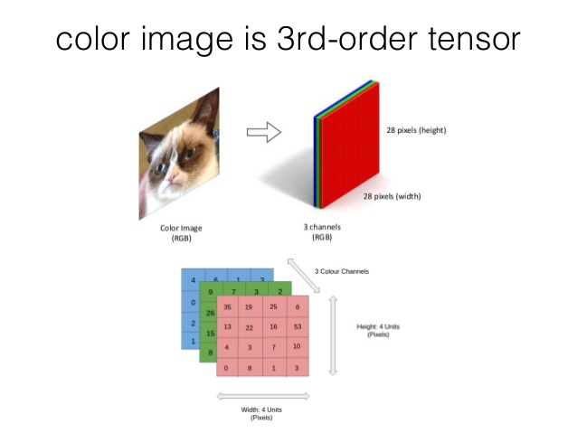
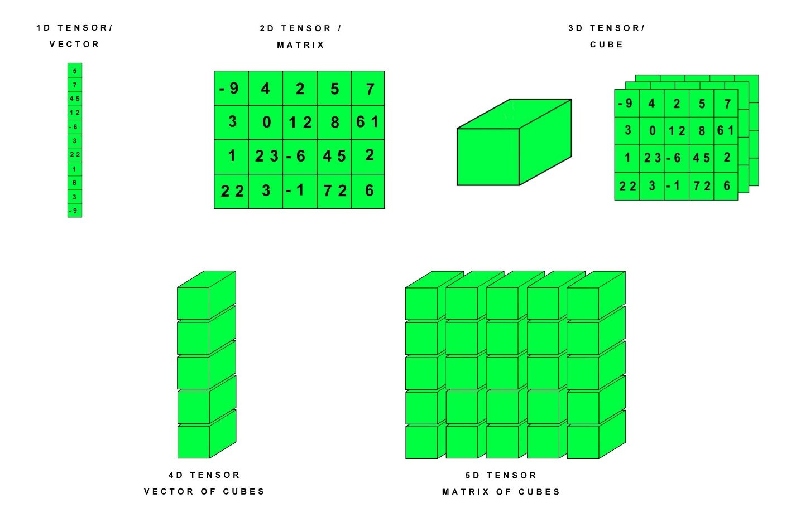
Tensors - Examples

Slide 8
Why Tensorflow is so popular?
It has become one of the go to frameworks for deep learning projects because..
TensorFlow provides excellent functionalities and services when compared to other popular deep learning frameworks.
TensorFlow provides an accessible and readable syntax
Has the ability to abstract lot of boilerplate code and configurations without reducing the flexibility and scalability.
TensorFlow is a low-level library which provides more flexibility(define your own functionalities or services for your models)
TensorFlow provides more network control using Tensorboard(helps understand how operations are implemented across the network)
Distributes the training time of a model over many servers to reduce the training time
Searching for good hyperparameters by running parallel experiments over multiple servers.
TensorFlow is available for web, mobile, edge, and embedded platforms
Notes:
The trend of distributed deep learning began in 2017, when Facebook released a paper showing a set of methods to reduce the training time of a convolutional neural network model. The test was done on RESNET-50 model on ImageNet dataset which took one hour to train instead of two weeks. 256 GPUs spread over 32 servers were used.

Slide 9
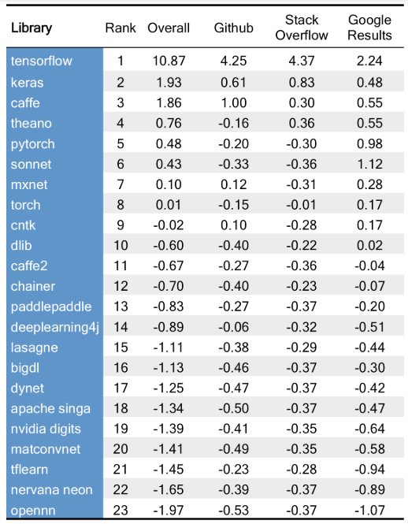
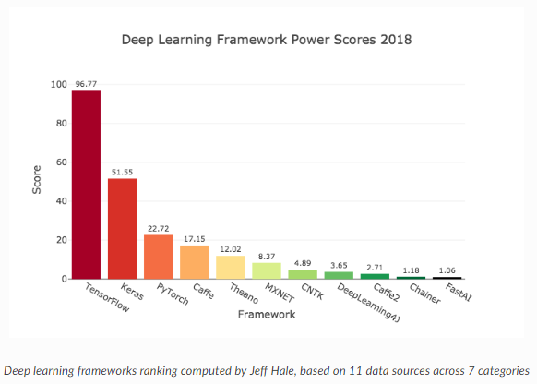
Tensorflow Ranking
Standardized scores from The Data Incubator.

Slide 10
Building blocks of Tensorflow
2
Collaborative Spirit | Unrelenting Dedication | Expert Thinking

Slide 11
Building blocks of Tensorflow
TensorFlow
Library for defining computational graphs
Runtime session for executing graphs
Notes:
on a variety of different hardware(CPU,GPU,TPU etc.,)

Slide 12
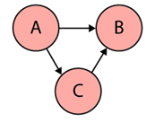
Directed graph & Computational Graph
Directed graph is a data structure consisting of nodes (vertices) and edges. It’s a set of vertices connected pairwise by directed edges.
Computational graph is an abstract way of describing computations as a directed graph
TensorFlow uses directed graphs internally to represent computations, and they call this data flow graphs (or computational graphs).
While nodes in a directed graph can be anything, nodes in a computational graph mostly represent operations, variables, or placeholders.
Operations create or manipulate data according to specific rules
Variables represent shared, persistent state that can be manipulated by running Operations on those variables
The edges correspond to data, or multidimensional arrays (so-called Tensors) that flow through the different operations(edges carry information from one node to another)
The output of one operation (one node) becomes the input to another operation and the edge connecting the two nodes carry the value

Slide 13
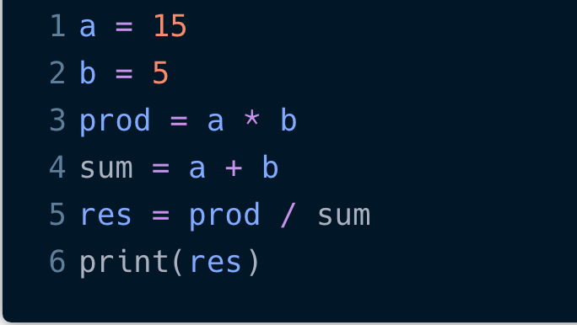
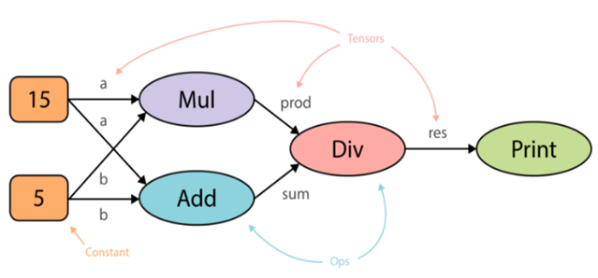
Program Vs Computational graph
Notes:
To create a computational graph out of this program, we create nodes for each of the operations in our program, along with the input variables a and b. In fact, a and b could be constants if they don’t change. If one node is used as the input to another operation we draw a directed arrow that goes from one node to another. First, we create two constants a and b . Then, we multiply them, take their sum and use the results of those two operations to divide one by the other. And finally, we print out the result.

Slide 14
Advantages of organizing computations as a directed graph
Computational graph is a more abstract way of describing a computer program and its computations
Most computer programs are mainly composed of two things — primitive operations and an order in which these operations are executed, often sequentially, line by line.
Program specifies the order of execution, but computational graphs exclusively specify the dependencies across the operations
This allows for parallelism or dependency driving scheduling(execute the multiplication and addition in parallel, as they do not depend on each other)
Uses the topology of the graph to drive the scheduling of operations and execute them in the most efficient manner.
e.g. using multiple GPUs on a single machine or even distribute the execution across multiple machines
Notes:
In other words, how would the output of these operations flow from one operation to another

Slide 15
Benefits/Advantages of Computational Graphs
3
Collaborative Spirit | Unrelenting Dedication | Expert Thinking

Slide 16
What are the benefits of using computational graphs?
Parallelism - By using explicit edges to represent dependencies between operations, it is easy for the system to identify operations that can execute in parallel.
Distributed execution - By using explicit edges to represent the values that flow between operations, it is possible for TensorFlow to partition your program across multiple devices (CPUs, GPUs, and TPUs) attached to different machines. TensorFlow inserts the necessary communication and coordination between devices.
Compilation - TensorFlow’s XLA(Accelerated Linear Algebra) compiler can use the information in your dataflow graph to generate faster code, for example, by fusing together adjacent operations.
Portability - The dataflow graph is a language-independent representation of the code in your model. You can build a dataflow graph in Python, store it in a SavedModel, and restore it in a C++ program for low-latency inference.

Slide 17
Components of Computational graphs in Tensorflow
Variables - These represent changeable parameters within the graph.
Eg., the weights or biases in a neural network.
Note: Tensorflow variables have to be initialized before running the graph in a session.
Placeholders - A placeholder allows us to feed data into the graph from outside and unlike variables they don’t need to be initialized. Placeholders simply define the shape and the data type.
Eg: Inputs and labels data.
Constants - Parameters that cannot be changed. Eg. Pi value, 3.14
Operations - Operations represent nodes in the graph that perform computations on Tensors. Eg. Matrix Multiplication, activation functions etc.,
Graph - A graph is like a central hub that connects all the variables, placeholders, constants to operations.
Session - A session creates a runtime in which operations are executed and Tensors are evaluated. It also allocates memory and holds the values of intermediate results and variables.
Notes:
We can think of placeholders as empty nodes in the graph where the value is provided later on.

Slide 18
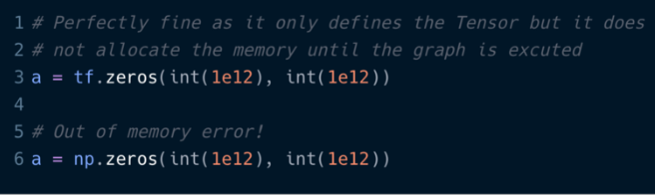
Graph and Session Class
The Graph class is used to construct the computational graph and the Session class is used to execute and evaluate all or a subset of nodes.
Main advantage of deferred execution is that during the definition of the computational graph we can construct very complex expressions without directly evaluating them and allocating the space in memory that is needed.
Eg: if we use Numpy to define a large matrix, say a trillion by a trillion, we would immediately get an out of memory error. In TensorFlow we would define a Tensor that is a description of a multidimensional array. It may have a shape and a data type but it does not have an actual value.
Declaration and execution allows TensorFlow to distribute the computational load across different devices (CPUs, GPUs, TPUs) attached to different machines.

Slide 19
Converting the simple program into a Tensorflow program
4
Collaborative Spirit | Unrelenting Dedication | Expert Thinking

Slide 20
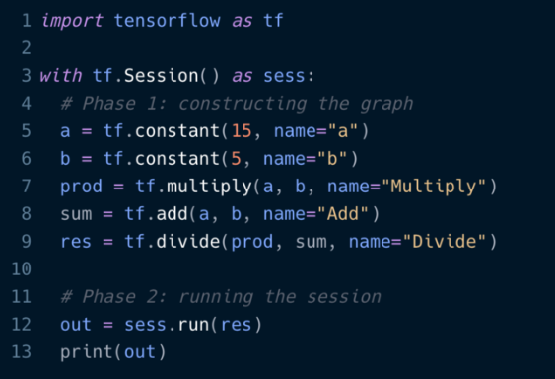
Converting the simple program into a Tensorflow program
With the core building blocks in place, to convert our simple program into a TensorFlow program, there are two phases:
Construction of the computational graph.
Running a session
TensorFlow provides a default graph for the current thread that is an implicit argument to all API functions in the same context. For advanced use cases we can also create multiple graphs.
Notes:
We start off by importing tensorflow. Next, we create a Session object within a with statement. This has the advantage that the session is automatically closed after the block was executed and we don’t have to call sess.close() ourselves. Now, inside the with-block, we can start constructing new TensorFlow operations (nodes) and thereby define the edges (Tensors). For example: This creates a new Constant Tensor with the name a that produces the value15. The name is optional.

Slide 21
Tensorboard
5
Collaborative Spirit | Unrelenting Dedication | Expert Thinking

Slide 22
TensorBoard: TensorFlow's visualization toolkit
TensorBoard provides the visualization and tooling needed for machine learning experimentation:
Tracking and visualizing metrics such as loss and accuracy
Visualizing the model graph (ops and layers)
Viewing histograms of weights, biases, or other tensors as they change over time
Displaying images, text, and audio data
Profiling TensorFlow programs etc.,

Slide 23
How to view graphs in Tensorboard
1. Install Tensorboard using pip or through Anaconda:
(py36) C:\Annie\Projects\Data Science COE\AI Initiative\AI Sessions\Tensorflow>pip install tensorboard
2. Write your tensorflow python code and save it as a .py file
3. To write the graph to your disk include the below code snippet of creating a writer object and adding the session graph to the object, with the name”/tsboard”
writer=tf.compat.v1.summary.FileWriter("/tsboard")
writer.add_graph(sess.graph)
4. In the terminal or Anaconda prompt, execute the below to run the tensorflow program:
(py36) C:\Annie\Projects\Data Science COE\AI Initiative\AI Sessions\Tensorflow>python Tensorflow_code.py
5. In the terminal or Anaconda prompt, execute the below code to invoke tensorboard and visualize the saved graph:
(py36) C:\Annie\Projects\Data Science COE\AI Initiative\AI Sessions\Tensorflow>tensorboard --logdir /tsboard
6. Access and view the tensorboard using the url: http://localhost:6006

Slide 25
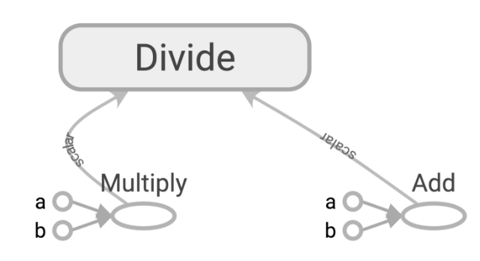
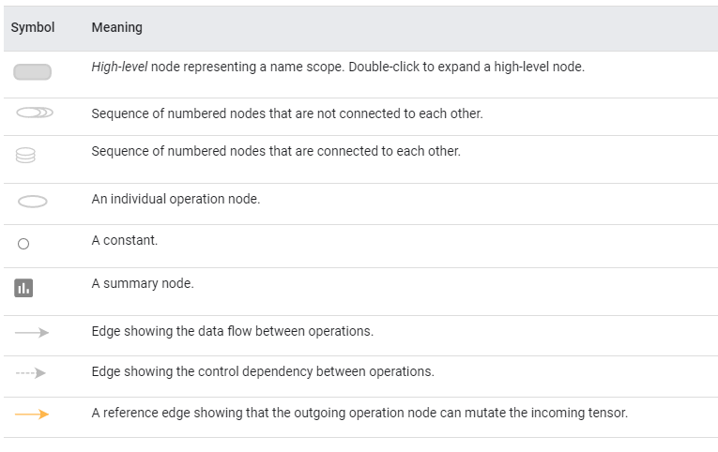
Visualizing the computational graph using Tensorboard

Slide 26
Installation of Tensorflow, Google Collab, Jupyter Notebook etc.,
6
Collaborative Spirit | Unrelenting Dedication | Expert Thinking

Slide 27
Installation of Tensorflow, Google Collab, Jupyter Notebook etc.,
Anaconda installation:
Create new environment with required Python 3.6 and install Tensorflow
Install Jupyter notebook in Anaconda
Install Tensorflow using pip
!pip install tensorflow
Import tensorflow as tf
Print(tf.__version__)
Google Collab Guide for using with Tensorflow - Jupyter Notebook in Google drive(for self-reference)
https://www.youtube.com/watch?v=inN8seMm7UI&list=PLQY2H8rRoyvyK5aEDAI3wUUqC_F0oEroL

Slide 28
Build simple neural network program using Tensorflow - Demo
7
Collaborative Spirit | Unrelenting Dedication | Expert Thinking

Slide 29
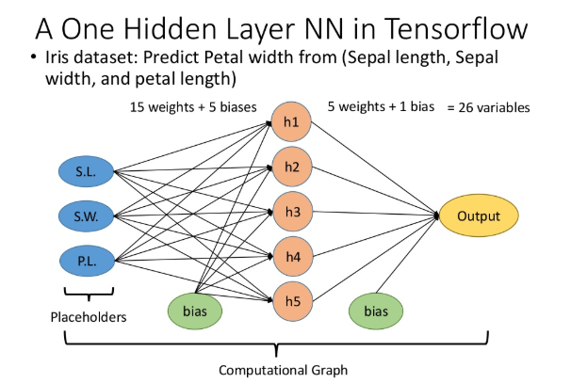
Simple One Hidden Layer Neural network computation graph

Slide 30
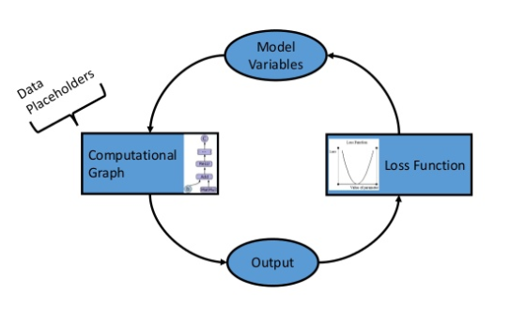
How do Tensorflow Algorithms work?

Slide 31
Simple Neural Network Using Tensorflow - Demo

Slide 32
Thank You
Collaborative Spirit | Unrelenting Dedication | Expert Thinking

